Slide 1
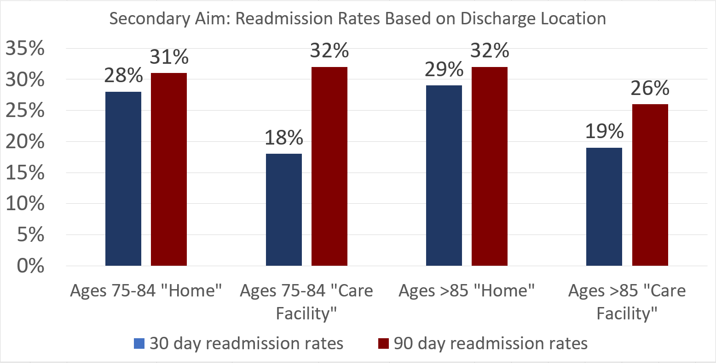
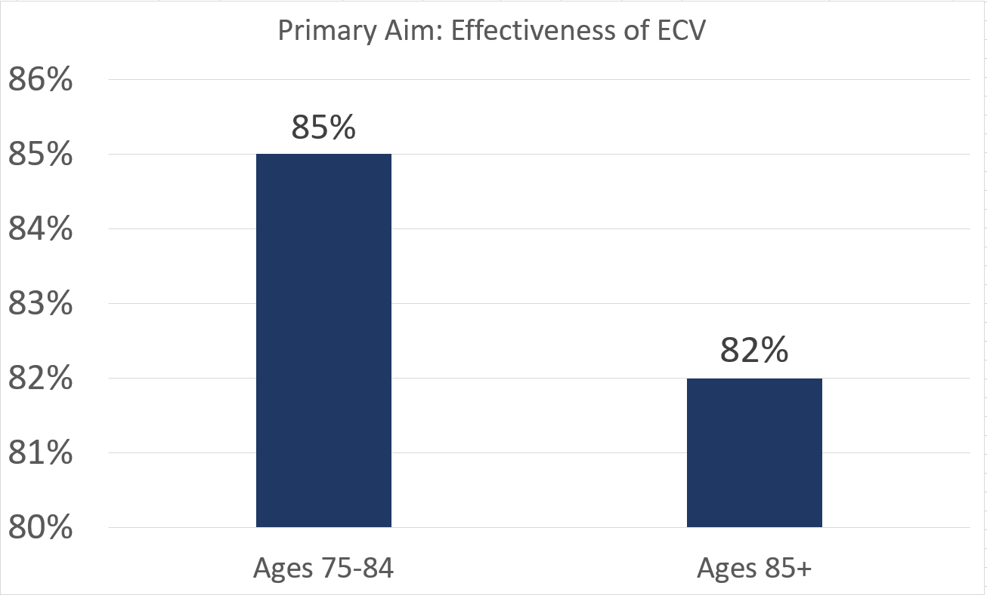
Effectiveness of Electrical Cardioversion among Older Adults in the Long-Term Care Setting Diagnosed with Atrial Fibrillation
Daniel Padron, MS3; Shannu Satyavolu, MD; Melisa Rodriguez Suliman, MS2; Adam Kirstein, MD; Gabriella Engstrom, PhD; Bernardo Reyes Fernandez, MD.
Florida Atlantic University, Schmidt College of Medicine
Background
Results
To our knowledge, there is limited information on electrical cardioversion (ECV) effectiveness among older adults.
The aim of this study is to determine the effectiveness of ECV among patients aged 75 and older.
Additionally, we aim to determine whether patients with an effective ECV who were discharged to a care facility, were less likely to return to the hospital at 30-or 90-days post discharge than patients who were discharged home.
Our cohort included 320 patients. From those, 189 (59%) were aged of 75-84, while 131 were >85 (41%).
There were no clinically significant differences in baseline characteristics between age groups.
Regarding the primary outcome, there was no statistically significant difference in the effectiveness of ECV between these two age groups. (Results in Figure 1)
Within the 75-84 age group and the >85 age group, the difference in 30-day and 90-day readmission rates was not statistically significant based on discharge location. (Results in Figure 2)
Methods
Figure 2
This is a retrospective study of adults aged > 75 admitted to a community teaching hospital from 11/2017 to 11/2020.
We included patients with the diagnosis of AF at the time of admission who underwent ECV during their admission.
We excluded patients with a diagnosis of cancer and those who had a contraindication to ECV.
Patients were grouped based on age. One group included patients aged 75-84, and another with those aged ≥85.
Patients were further stratified based on discharge location. Patients discharged home independently or with home health were designated as “Home”, while those discharged to an acute rehab, skilled nursing facility, or other long-term care setting, were designated as “Care Facility”.
ECV effectiveness was defined as the presence of sinus rhythm at the time of discharge.
Conclusion
We reported no difference on ECV effectiveness between patients aged 75-84 and those >85 diagnosed with AF.
Likewise, the effectiveness of ECV did not affect hospital return rates, regardless of age, baseline characteristics, or discharge location
Our results support the continued use of ECV in geriatric populations, consistent with current guidelines in younger populations.
However, given the lack of significant reduction in hospital readmissions, the question of whether ECV leads to better long-term outcomes in these patients still remains.
p=0.415
Figure 1

